Slide 1
SITE Reliability Engineering Training phase 1 – Dec 14to 23rd
Topics
S/W. Development Models
[ Agile, DevOps, DevSecOps]
SRE
Virtual Box, Vagrant, NGINX [ Linux]
Container - Dockers

Slide 2
Content [Module 2] Dec 14th – 16th
Accessing Virtual Machines
Using VirtualBox
Deep Dive to Vagrant
Vagrant, vagrant boxes, vagrantfile, provisioning tools etc.

Slide 3
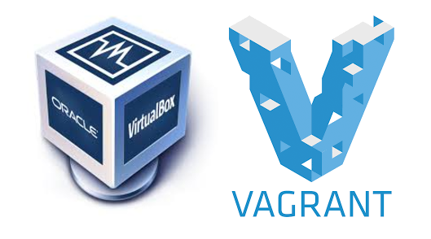
Installing VirtualBox and Vagrant on Windows VM
VirtualBox is basically inception for your computer. You can use VirtualBox to run entire sandboxed operating systems within your own computer.
Vagrant is software that is used to manage a development environment. Through the command line, you can grab any available OS, install it, configure it, run it, work inside of it, shut it down, and more.
Notes:
VirtualBox is probably a new term for most of you out there, but it is on the similar lines of VMware, docker and other vendors that offer operating-system level virtualization services for software development — or Container, to be generic! It is offered by the age-old Oracle.
VirtualBox usually goes hand-in-hand with Vagrant — an open-source software product by HashiCorp for building and maintaining portable virtual software development environments. So it acts as an agent that simplifies all the virtual environment configurations, meaning that developers can focus on developing and be more productive.
Using VirtualBox and Vagrant, you can simulate the production environment of your app or website. For example, if you're using Digital Ocean or AWS to run a Virtual Private Server (VPS) in the cloud running Ubuntu, PHP, and MySQL, you can install your local version to have all the same versions of that software, while keeping your own computer's software untouched. This can reduce and eliminate bugs and errors that result from trying to develop code for a production server on an environment that does not match.

Slide 4

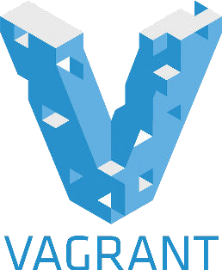

Why people are using it?

Slide 5
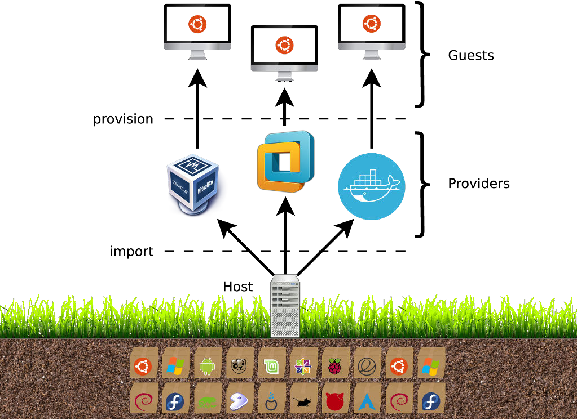
THE BASICS
Terminology & Workflow

Slide 6
What Vagrant Can Do for us ?
A brief introduction to Vagrant
Vagrant is an open source software for building and maintaining virtual software development environments. It provides a clean, easy to configure, reproducible, and portable development environment. In other words, Vagrant allows us to easily and quickly deploy an universal software development environment that can be used anywhere. Vagrant simply eliminates the "works on my machine" excuse. Because, everyone is working on the same environment with same set of configuration. It doesn't matter what OS they are using.
https://www.vagrantup.com/
It can manage the lifecycle of a project.
We can share machines. We can create stop halt machines.
Helps in creating virtual machines in your local environment.
It makes easy provisioning virtual machines with a shell script or SCM tools like chef or puppet or Ansible in CI CD Pipeline.
Notes:
Vagrant is often used to setup an identical and collaborative working environment for developers to work on a common project. It isolates all required dependencies and their configuration settings in a single, disposable environment. When the other developers create a development environment with the same configuration file, they will get the same environment with same settings.
Vagrant is a cross-platform application written in Ruby language. It supports GNU/Linux, Mac OS and Microsoft Windows. It is developed by Hashicorp and released under MIT license.
Vagrant is an open-source tool that allows you to create, configure, and manage boxes of virtual machines through an easy to use command interface. Essentially, it is a layer of software installed between a virtualization tool (such as VirtualBox, Docker, Hyper-V) and a VM.
It is often used in software development to ensure all team members are building for the same configuration. Not only does it share environments, but it also shares code as well. This allows the code from one developer to work on the system of another, making collaborative and cooperative development possible.

Slide 7
Knowing more about Vagrant
Note - Before you start, make sure you already have a virtualization solution on your system. Solutions that work with Vagrant include VirtualBox, VMware, Docker, Hyper-V, and custom solutions.
Vagrant Boxes
The basic unit in a Vagrant setup is called a “box” or a “Vagrantbox.” This is a complete, self-contained image of an operating system environment.
A Vagrant Box is a clone of a base operating system image. Using a clone speeds up the launching and provisioning process.
VagrantFile
Instead of building out a complete operating system image and copying it, Vagrant uses a “Vagrantfile” to specify the configuration of the box.
Notes:
Vagrant does the following, with one single command.
Installing a brand new operating system using virtualization is also time consuming. Vagrant solves this problem by using a base image. In the vagrant terminology this particular base image (for example Ubuntu 12.04 base image, Ubuntu 14.04 base image, Centos 6 Base image), used for setting up a virtual machine really fast, is called a "Box". Boxes are distributed using boxfiles.
Boxes contain already installed operating system, which is the reason box files are usually a few hundred megabytes. Consider box files as a source code to setup, a virtualized base operating system inside the virtualization platform that you are using.
Configures the virutal machine specific settings like Hostnames, Resource allocation, Network configuration etc.
Vagrant also is capable of executing configuration management softwares like Puppet or Chef once the base system is ready(using box). Using these configuration management utilities, you will be able to setup the development environment with required application settings.
Vagrantfile
The primary function of the Vagrantfile is to describe the type of machine required for a project, and how to configure and provision these machines. Vagrantfiles are called Vagrantfiles because the actual literal filename for the file is Vagrantfile (casing does not matter unless your file system is running in a strict case sensitive mode).
Vagrant is meant to run with one Vagrantfile per project, and the Vagrantfile is supposed to be committed to version control. This allows other developers involved in the project to check out the code, run vagrant up, and be on their way. Vagrantfiles are portable across every platform Vagrant supports.
The syntax of Vagrantfiles is Ruby, but knowledge of the Ruby programming language is not necessary to make modifications to the Vagrantfile, since it is mostly simple variable assignment. In fact, Ruby is not even the most popular community Vagrant is used within, which should help show you that despite not having Ruby knowledge, people are very successful with Vagrant.

Slide 8
Vagrant Basic Commands
Vagrant basic command
Vagrant ssh-config -------------- how to work ssh
Vagrant globle-status ----------- to check install machine
Vagrant status ----- show status , running or stopped
Vagrant ip-show --- show ip add
Vagrant stop ------ stooped
Vagrant reload ----- stopped and start
Vagrant destroy --- remove or delete
Vagrant halt ------ shutdown system
Notes:
Vagrantfile
The primary function of the Vagrantfile is to describe the type of machine required for a project, and how to configure and provision these machines. Vagrantfiles are called Vagrantfiles because the actual literal filename for the file is Vagrantfile (casing does not matter unless your file system is running in a strict case sensitive mode).
Vagrant is meant to run with one Vagrantfile per project, and the Vagrantfile is supposed to be committed to version control. This allows other developers involved in the project to check out the code, run vagrant up, and be on their way. Vagrantfiles are portable across every platform Vagrant supports.
The syntax of Vagrantfiles is Ruby, but knowledge of the Ruby programming language is not necessary to make modifications to the Vagrantfile, since it is mostly simple variable assignment. In fact, Ruby is not even the most popular community Vagrant is used within, which should help show you that despite not having Ruby knowledge, people are very successful with Vagrant.

Slide 9
Setting vagrant on virtual machine
Download and install Vagrant
$ mkdir mydirectory $ cd /mydirectory
We’ll install a Ubuntu 14.04 server as our VM
$ vagrant box add ubuntu/trusty64
$ vagrant init ubuntu/trusty64 - to initialize VM
$ vagrant up
$ vagrant ssh
Exit & vagrant halt [in case not able to access instance, install plugin]
$ vagrant plugin install vagrant-vbguest
$ vagrant reload
Notes:
`Vagrantfile` has been placed in this directory. You are now ready to `vagrant up` your first virtual environment! Please read the comments in the Vagrantfile as well as documentation on `vagrantup.com` for more information on using Vagrant.

Slide 10
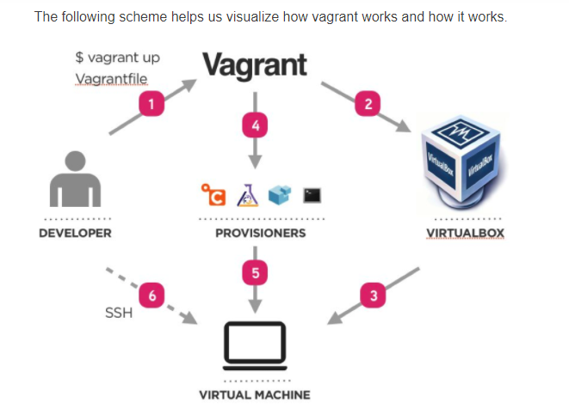
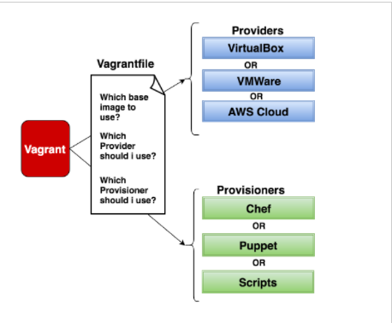
Vagrant Workflow
Notes:
Environments managed by Vagrant can run on local virtualized platforms such as VirtualBox or VMware, in the cloud via AWS or OpenStack, or in containers such as with Docker.
Vagrant provides the framework and configuration format to create and manage complete portable development environments. These development environments can live on your computer or in the cloud, and are portable between Windows, Mac OS X, and Linux.
In a nutshell, Vagrant manages the environments, and uses, for example, VirtualBox to provide (launch) the machines. Scripts that run after the machines are launched can be configured through several provisioners such as the shell, Terraform, Chef and Ansible. Provisioners are meant to leverage provisioning (installing dependencies), automation, configuration management, and orchestration. This meets the DevOps way of thinking and working.

Slide 11

Vagrant Workflow - Terminology
Before I’ll go into the details, I’d like to define a few terms from the Vagrant world:
Provider: A provider is simply a platform that can create and run VMs. This could be a locally installed hypervisor, e.g. Hyper-V (Windows) or VirtualBox, which are supported by Vagrant out of the box. But Vagrant can also be extended by plug-ins. There are many provider plug-ins, e.g. for Amazon Web Services (AWS) or Microsoft’s Azure, which can also act as providers. Think of them as remote hypervisors.
Box: an immutable virtual disk image (and a few meta-data files) of a virtualized system. A box is specifically built for a specific provider. Boxes are stored in a repository. HashiCorp, the maker of Vagrant, runs such a repository, the Vagrant Cloud, which has thousands of ready-to-use boxes for all kinds of operating systems. In a separate article I’ll explain how you can build your own boxes.
VM: the mutable copy of an immutable box. Vagrant essentially clones a box and turns it into a VM that you can work in (and whose disk content you can change).
Vagrantfile: a regular text file which is the recipe that specifies how Vagrant should build a VM from a box. It references the base box that should be cloned, and contains statements that configure the VM once it has started. This configuration phase is called provisioning in the Vagrant world.
Provisioner: a configuration management software that Vagrant installs into the VM and that facilitates provisioning of the VM. While you could just specify shell commands in the Vagrantfile to install software, these would not be portable, because installing software on different Linuxes, or Windows, works completely differently. Fortunately, Vagrant supports a number of provisioners (and knows how to install their run-times), such as Docker, Chef, Puppet or Ansible.

Slide 12
You might wonder what you need a tool like Vagrant for, so here are a few examples:
Evaluating software: no matter if you’re an “end-user” or a professional who wants to test a (time-limited) piece of software: now you can. With Vagrant you set up any virtual operating system, of any version, in minutes.
Manual or automated (black-box) system testing: if you make software that runs on several operating systems (and different versions, like Windows 7, 8.1, or 10), maintaining a set of physical machines is expensive and cumbersome. With Vagrant you can quickly create fresh operating systems (in a defined state) and test whether your software successfully installs and runs on those.
Continuous Integration (CI): use Vagrant to set up virtual build machines or test runners that contain your required compilers and other tools.
Virtual development environments: with Vagrant you can create virtual machines that come with a preconfigured set of tools, allowing your team members to get started with development quickly.
Vagrant USE Cases

Slide 13
How Vagrant benefits me?
Developer, say goodbye to "works on my machine" bugs.
Operations engineer, stop juggling SSH prompts to various machines, and start using Vagrant to bring sanity to your life.
Tester, Just check out the code, vagrant up, and start designing.

Slide 14
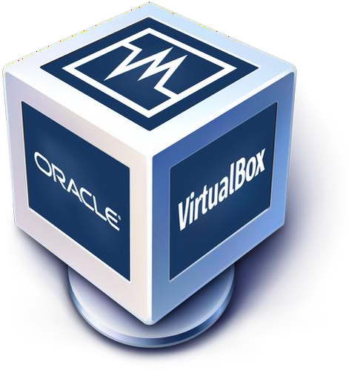

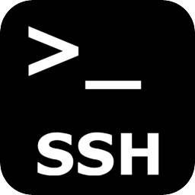
Required Tools
+ +

Slide 15
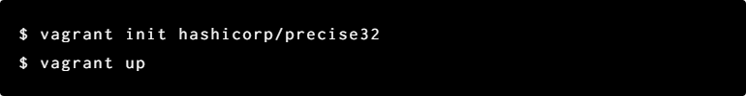
Getting started with Vagrant

Slide 16
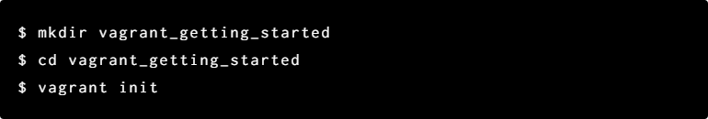
Project setup

Slide 17
Installing a box

Slide 18
UP and SSH

Slide 19

Synced folder

Slide 20
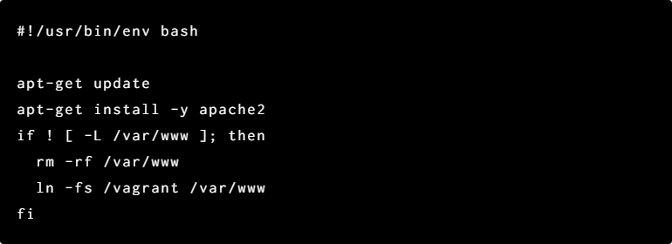
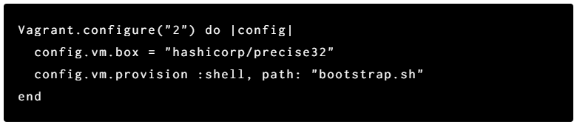
Provisioning

Slide 21
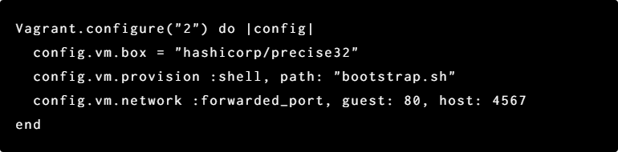
Networking
Port forwarding:

Slide 22
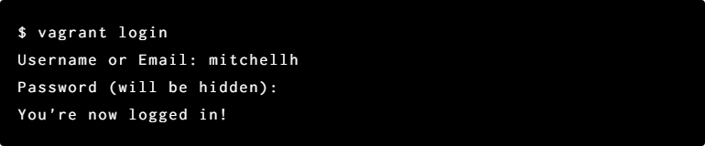
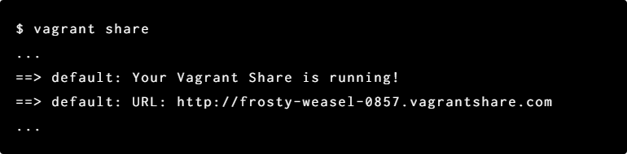
Share with universe
Login to Hashicorp's Atlas:
Share:

Slide 23
Tear down
vagrant suspend
vagrant halt
vagrant destroy

Slide 24
Rebuild

Slide 25
Snapshot
vagrant snapshot push
vagrant snapshot pop
vagrant snapshot save name
vagrant snapshot restore name
vagrant snapshot list
vagrant snapshot delete

